Slide 1
Deep Generative Models for Natural Images
Adam Anderson
Mentor: Matt Whiteway
UMD Directed Reading Program
Spring 2017

Slide 2
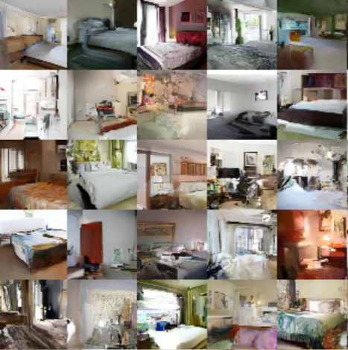
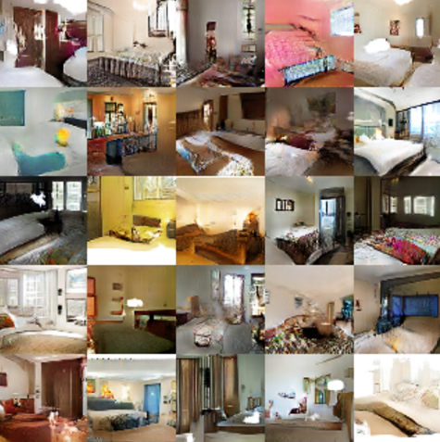

Slide 3
PixelVAE: A Latent Variable Model for Natural Images – Gulrajani et al (2016).
Unsupervised Representation Learning with Deep Convolutional Generative Adversarial Networks –Radford, Metz, Chintala (2016).

Slide 4
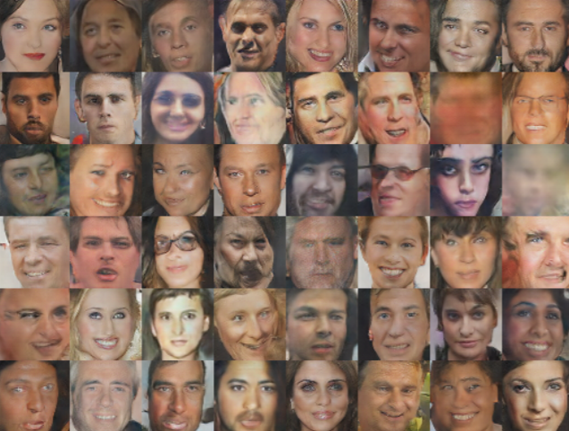
Unsupervised Representation Learning with Deep Convolutional Generative Adversarial Networks -- Radford, Metz, Chintala (2016).

Slide 5
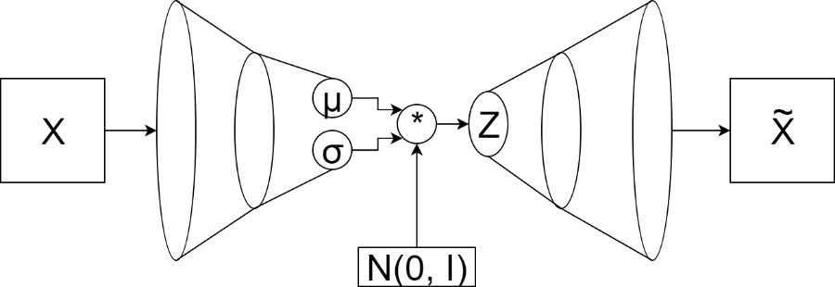
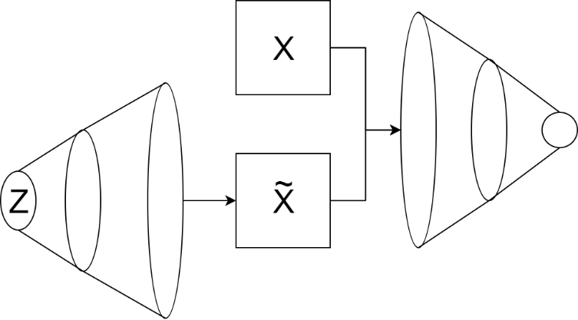
Agenda
Latent Variable Models
Neural Networks
Variational Autoencoder
Generative Adversarial Network

Slide 6
Latent Variable Models

Slide 7

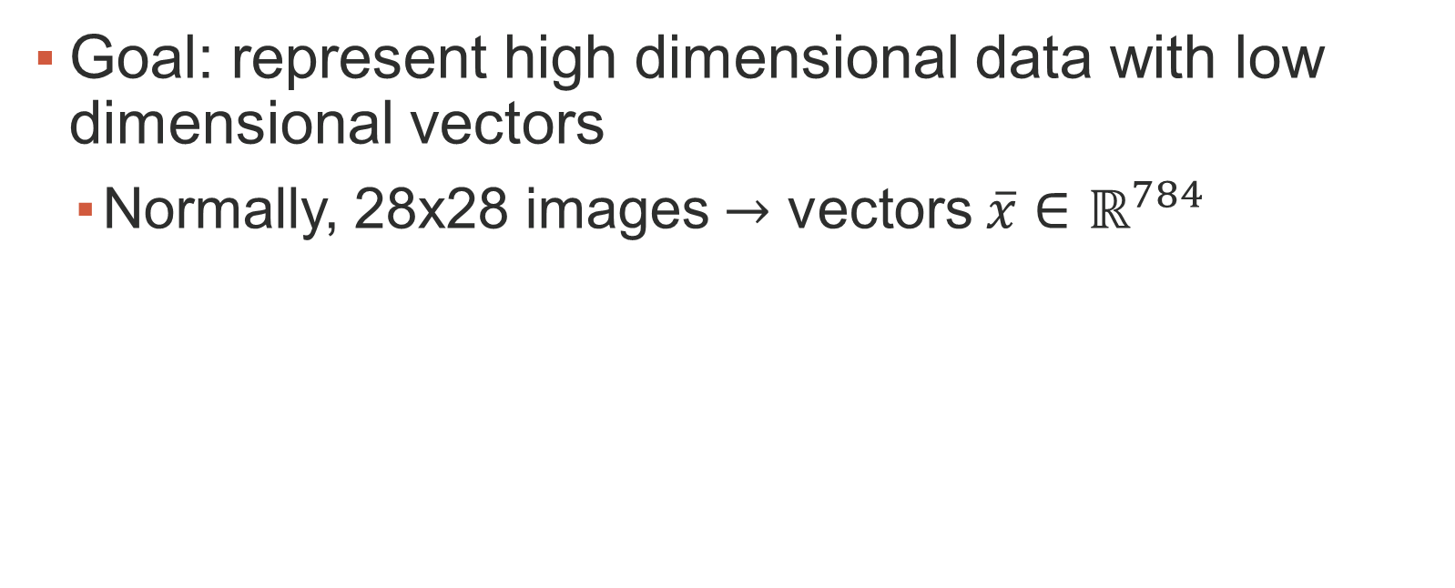
Latent Variable Models
Goal: represent high dimensional data with low dimensional vectors
Normally, 28x28 images $→$ vectors $\overline{x}∈ℝ^{784}$

Slide 8
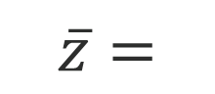
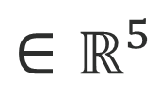
Latent Variable Models
8
0.5
0
5
5
9
0
-5
10
5
0
0
0
0
3
Number (0-9)
X-translation
Y-translation
Rotation
Thickness
$$\overline{z}=$$
$$∈ℝ^{5}$$

Slide 9
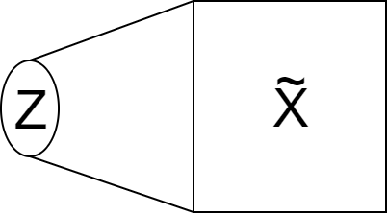
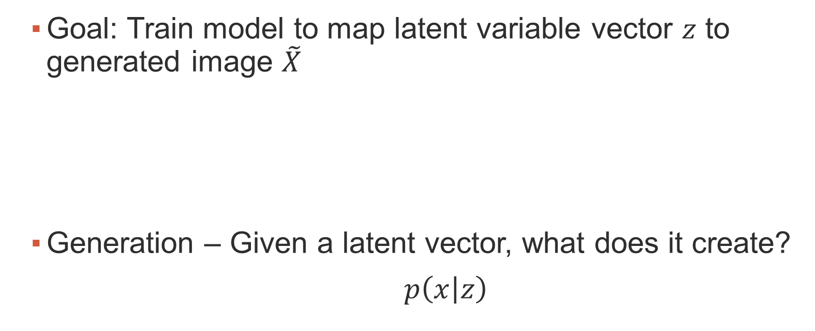
Latent Variable Models
Goal: Train model to map latent variable vector $z$ to generated image $\tilde{X}$
Generation – Given a latent vector, what does it create?
$p\left(\left.x\right|z\right)$

Slide 10
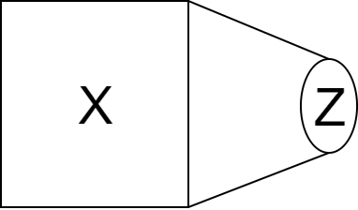
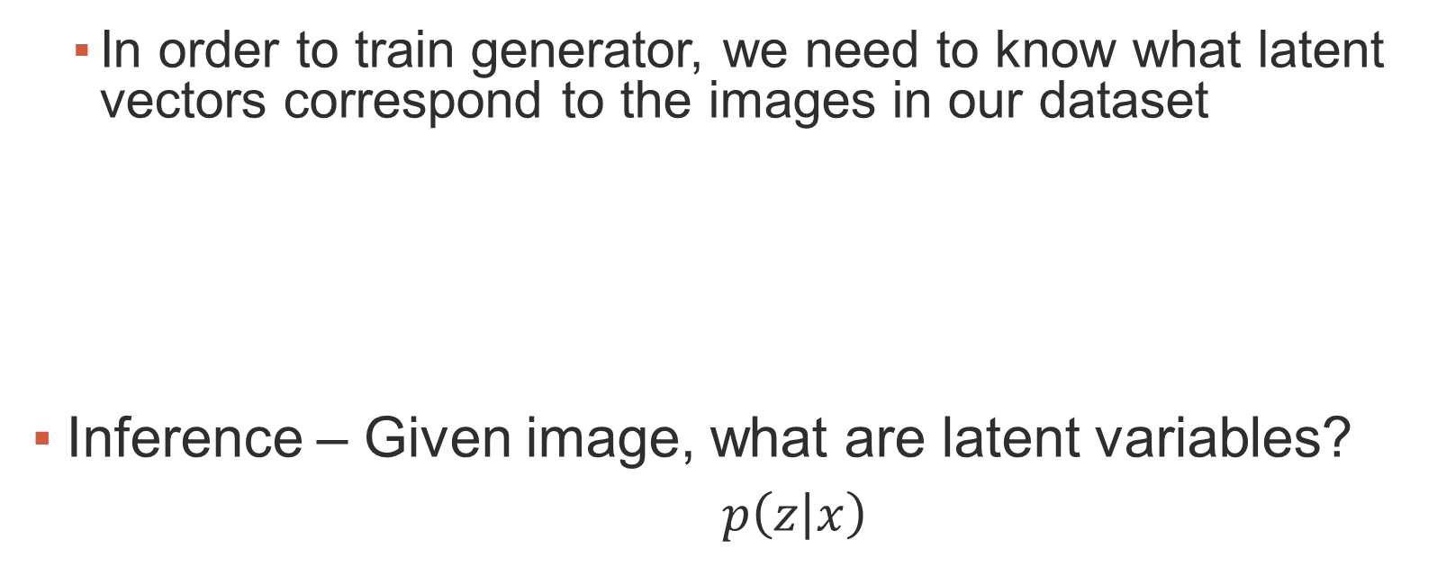
Latent Variable Models
In order to train generator, we need to know what latent vectors correspond to the images in our dataset
Inference – Given image, what are latent variables?
$p\left(\left.z\right|x\right)$

Slide 11
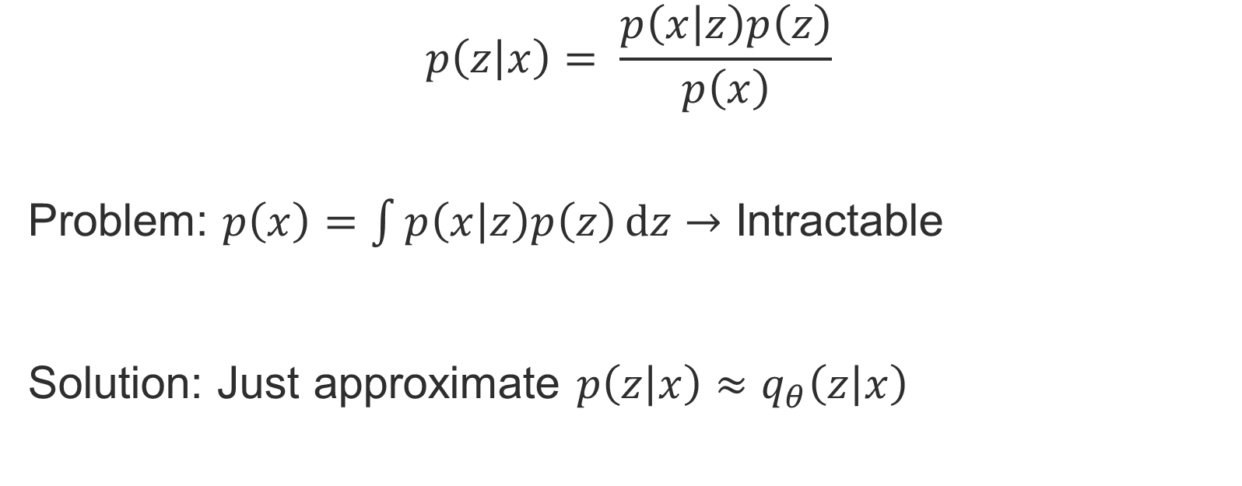
Latent Variable Models
$$p\left(\left.z\right|x\right)= \frac{p\left(\left.x\right|z\right)p\left(z\right)}{p\left(x\right)}$$
Problem: $p\left(x\right)=\int{p\left(\left.x\right|z\right)p\left(z\right)ⅆz}→$ Intractable
Solution: Just approximate $p\left(\left.z\right|x\right)≈q_{θ}\left(\left.z\right|x\right)$

Slide 12
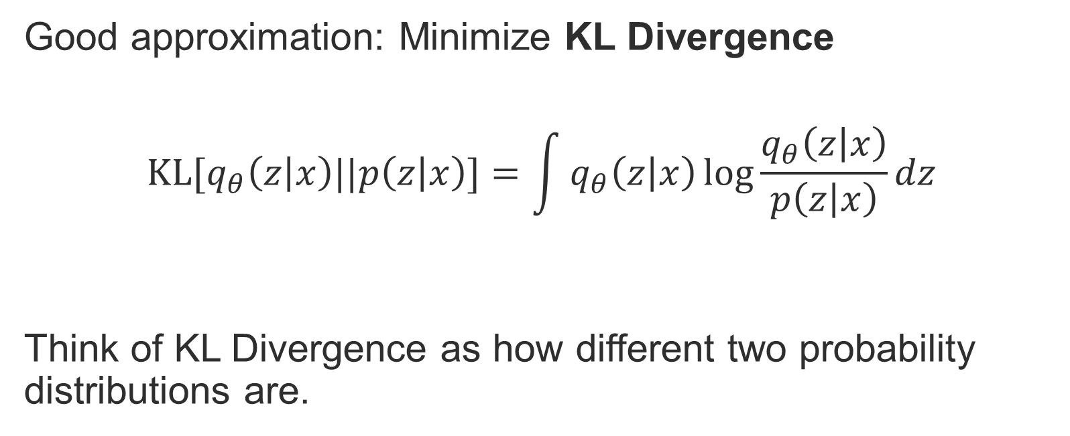
Latent Variable Models
Good approximation: Minimize KL Divergence
$$KL[q_{θ}\left(\left.z\right|x\right)||p\left(\left.z\right|x\right)]=\int{q_{θ}\left(\left.z\right|x\right)\log{\frac{q_{θ}\left(\left.z\right|x\right)}{p\left(\left.z\right|x\right)}}dz}$$
Think of KL Divergence as how different two probability distributions are.

Slide 13
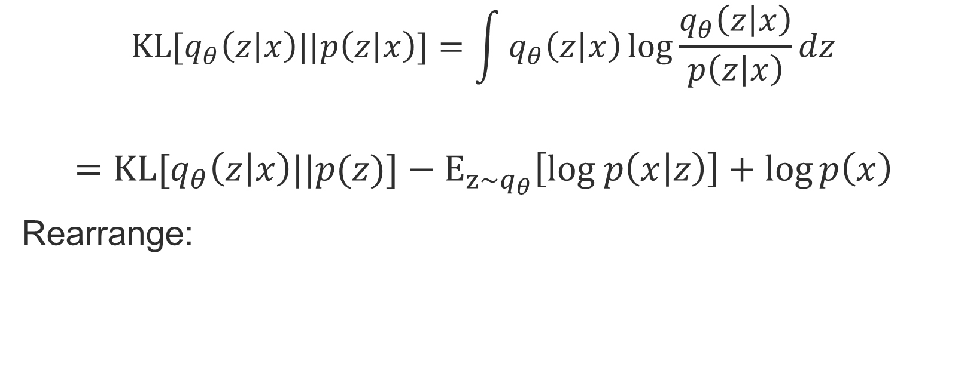
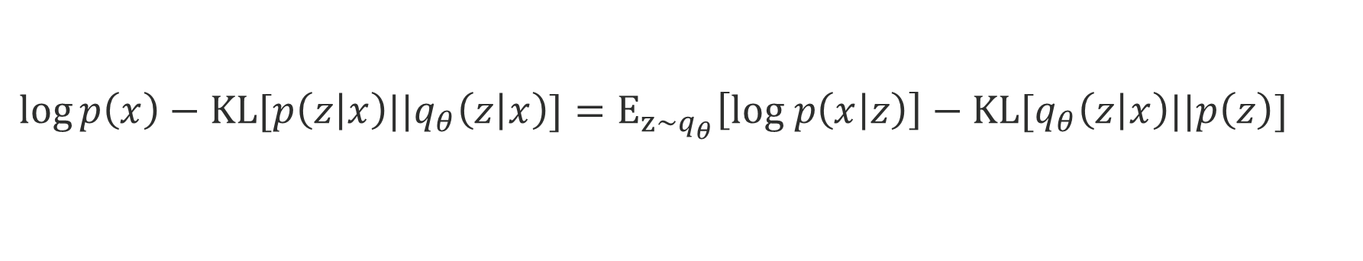
Latent Variable Models
$$KL[q_{θ}\left(\left.z\right|x\right)||p\left(\left.z\right|x\right)]=\int{q_{θ}\left(\left.z\right|x\right)\log{\frac{q_{θ}\left(\left.z\right|x\right)}{p\left(\left.z\right|x\right)}}dz}$$
$$={KL[q}_{θ}\left(\left.z\right|x\right)||p(z)]−E_{z\sim q_{θ}}\left[log p\left(\left.x\right|z\right)\right]+\log{p\left(x\right)}$$
Rearrange:
$$\log{p\left(x\right)}−KL[p\left(\left.z\right|x\right)||q_{θ}\left(\left.z\right|x\right)]=E_{z\sim q_{θ}}\left[log p\left(\left.x\right|z\right)\right]−{KL[q}_{θ}\left(\left.z\right|x\right)||p\left(z\right)]$$

Slide 14
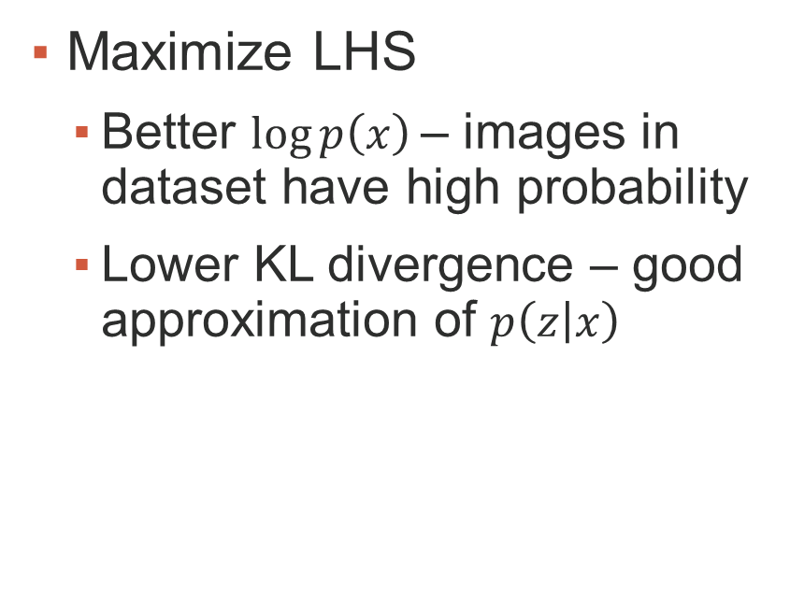

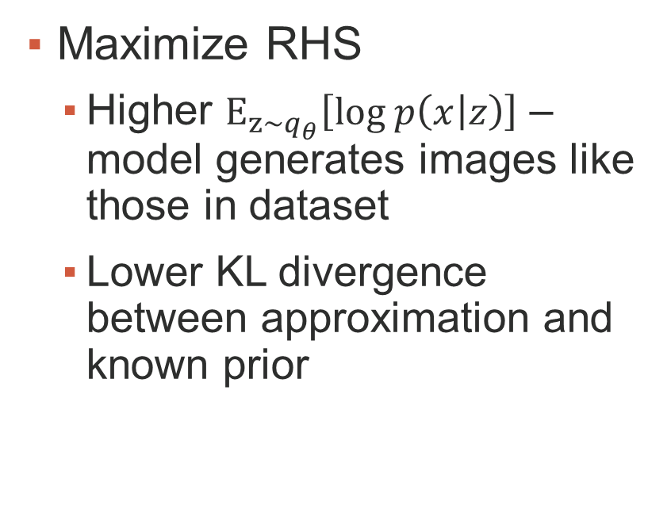
$$\log{p\left(x\right)}−KL[q_{θ}\left(\left.z\right|x\right)||p\left(\left.z\right|x\right)]=E_{z\sim q_{θ}}\left[log p\left(\left.x\right|z\right)\right]−{KL[q}_{θ}\left(\left.z\right|x\right)||p\left(z\right)]$$
Maximize LHS
Better $\log{p\left(x\right)}$– images in dataset have high probability
Lower KL divergence – good approximation of $p\left(\left.z\right|x\right)$
Maximize RHS
Higher $E_{z\sim q_{θ}}\left[log p\left(\left.x\right|z\right)\right]$ – model generates images like those in dataset
Lower KL divergence between approximation and known prior

Slide 15
Neural Networks

Slide 16
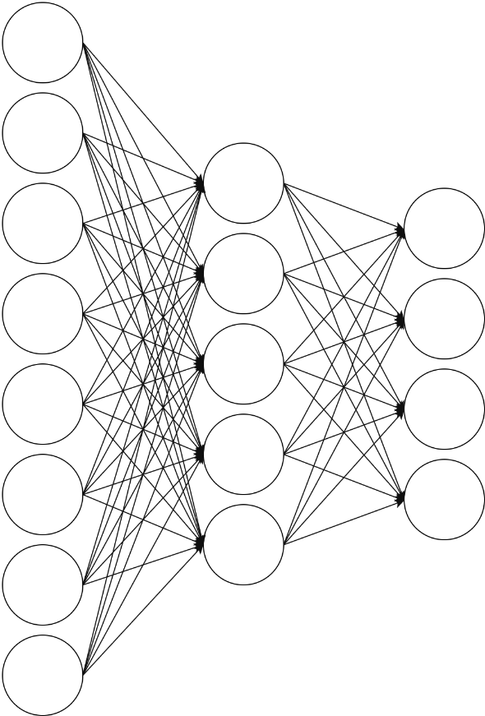
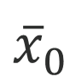
Neural Networks
Weights on activation going into node in next layer
$${\overline{x}}_{0}$$
W₂
Weights on activation coming from node in previous layer
W₁

Slide 17
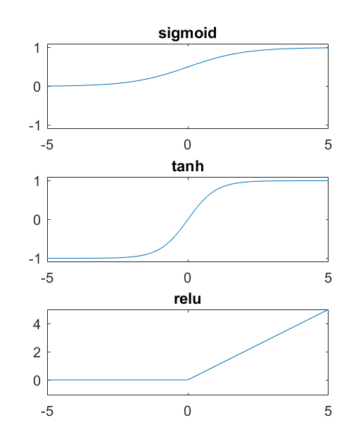
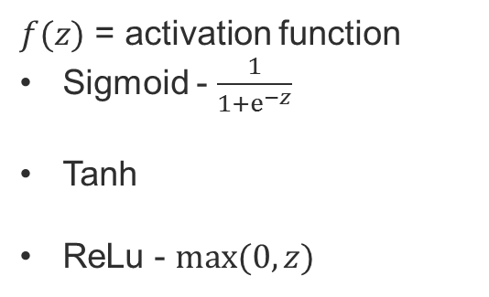
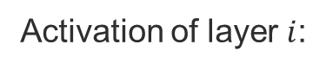
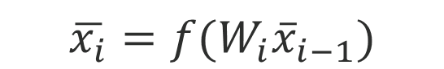
Neural Networks
Activation of layer $i$:
$$\overline{x_{i}}=f(W_{i}{\overline{x}}_{i−1})$$
$f(z)$ = activation function
Sigmoid - $\frac{1}{1+ⅇ^{−z}}$
Tanh
ReLu - $max⁡(0, z)$
$${\overline{x}}_{0}$$
W₂
W₁

Slide 18
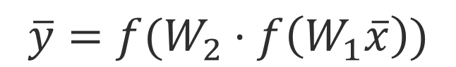
Neural Networks
$${\overline{x}}_{0}$$
$$\overline{y}=f(W_{2}⋅f\left(W_{1}\overline{x}\right))$$
W₂
W₁

Slide 19
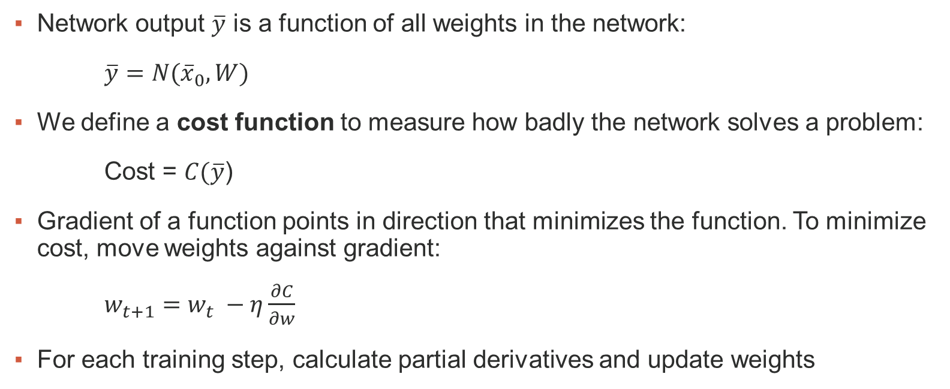
Neural Networks
Network output $\overline{y}$ is a function of all weights in the network:
$\overline{y}=N({\overline{x}}_{0}, W)$
We define a cost function to measure how badly the network solves a problem:
Cost = $C(\overline{y}$)
Gradient of a function points in direction that minimizes the function. To minimize cost, move weights against gradient:
$w_{t+1}=w_{t} −η\frac{∂C}{∂w}$
For each training step, calculate partial derivatives and update weights

Slide 20
Variational Autoencoders

Slide 21

Variational Autoencoder
Regular autoencoder:
Project input to low dimension, project back to higher dimension

Slide 22
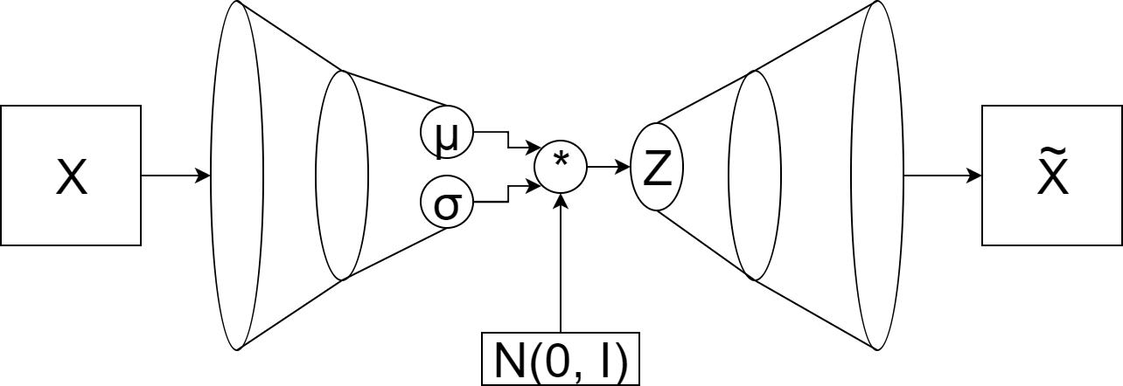
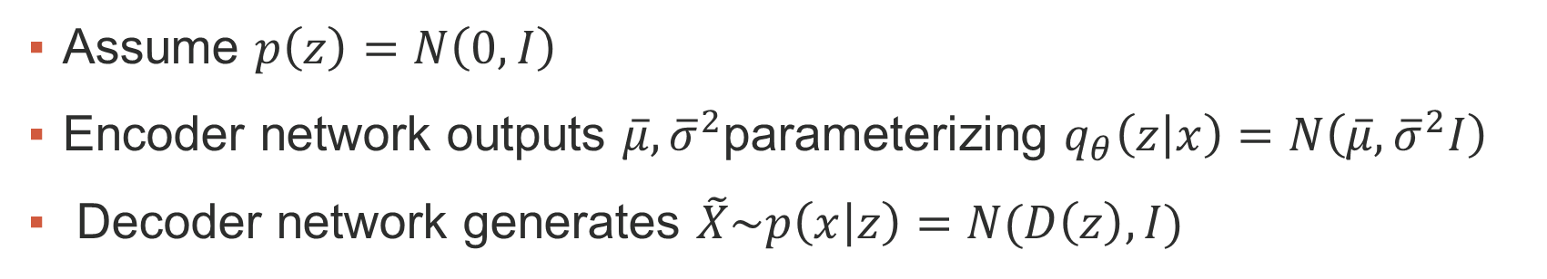
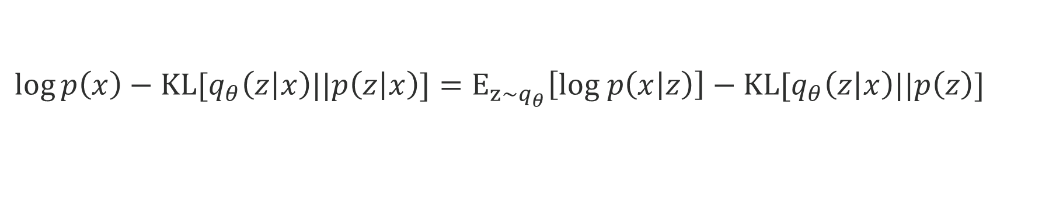
Variational Autoencoder
$$\log{p\left(x\right)}−KL[q_{θ}\left(\left.z\right|x\right)||p\left(\left.z\right|x\right)]=E_{z\sim q_{θ}}\left[log p\left(\left.x\right|z\right)\right]−{KL[q}_{θ}\left(\left.z\right|x\right)||p\left(z\right)]$$
Assume $p\left(z\right)=N\left(0, I\right)$
Encoder network outputs $\overline{μ}, {\overline{σ}}^{2}$parameterizing $q_{θ}\left(\left.z\right|x\right)=N\left(\overline{μ},{\overline{σ}}^{2}I\right)$
Decoder network generates $\tilde{X}\sim p\left(x | z\right)=N(D\left(z\right), I)$

Slide 23
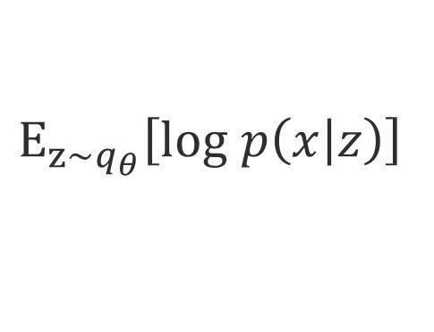
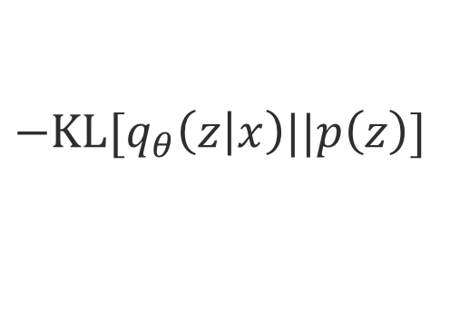
$$E_{z\sim q_{θ}}\left[log p\left(\left.x\right|z\right)\right]$$
$${−KL[q}_{θ}\left(\left.z\right|x\right)||p\left(z\right)]$$
KL divergence tries to make latent vectors ~ independent unit Gaussian
Expectation tries to make outputs look like inputs

Slide 24
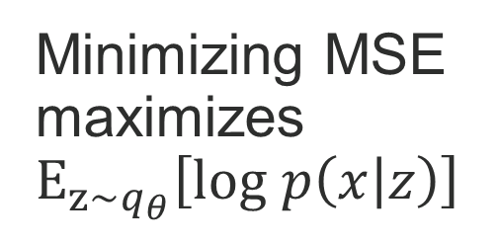
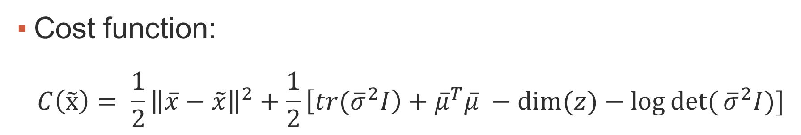
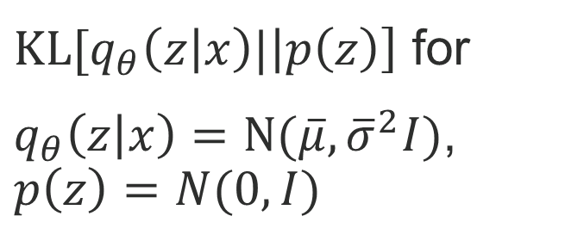
Variational Autoencoder
Cost function:
$$C\left(\tilde{x}\right)= \frac{1}{2}{\left\|\overline{x}−\tilde{x}\right\|}^{2}+\frac{1}{2}\left[{tr(\overline{σ}}^{2}I\right)+{\overline{μ}}^{T}\overline{μ} −dim⁡(z)−\log{det⁡(}{\overline{σ}}^{2}I)]$$
Minimizing MSE maximizes $E_{z\sim q_{θ}}\left[log p\left(\left.x\right|z\right)\right]$
${KL[q}_{θ}\left(\left.z\right|x\right)|\left|p\left(z\right)\right]$ for
$q_{θ}\left(\left.z\right|x\right)=N(\overline{μ}, {\overline{σ}}^{2}I)$,
$$p\left(z\right)=N(0, I)$$

Slide 25
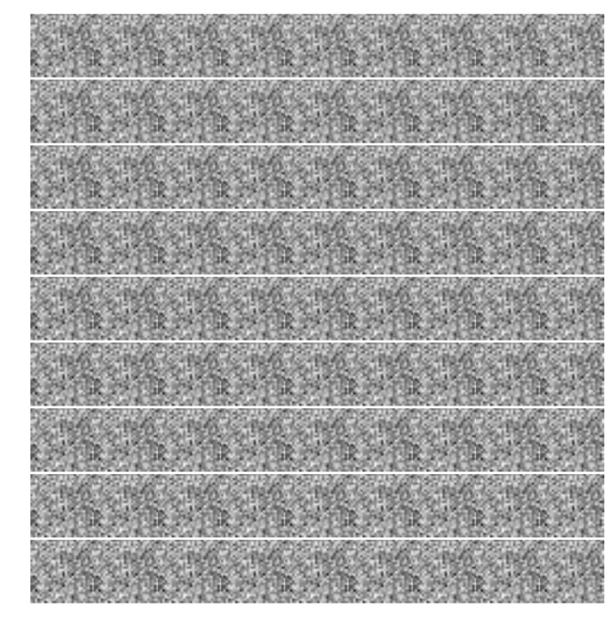

Slide 26
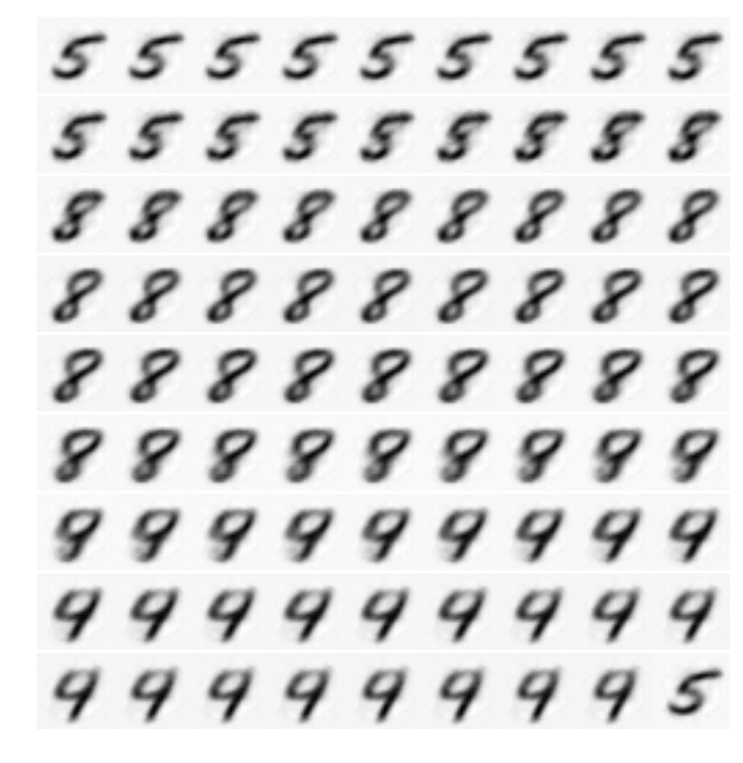

Slide 27
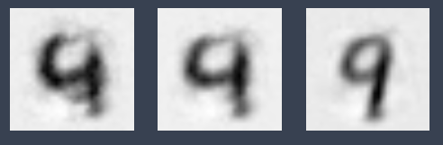






Slide 28
Generative Adversarial Networks

Slide 29
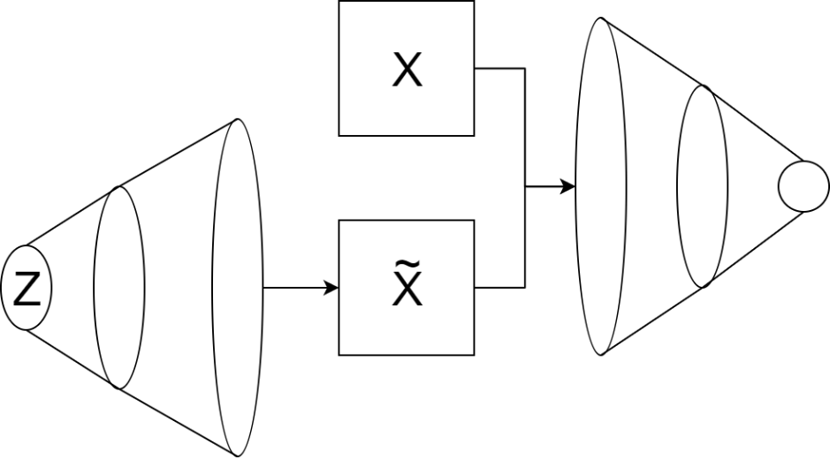
Generative Adversarial Networks
Generator Network
Create images from some prior distribution
Discriminator Network
Learn to recognize which images are from dataset, which are generated

Slide 30
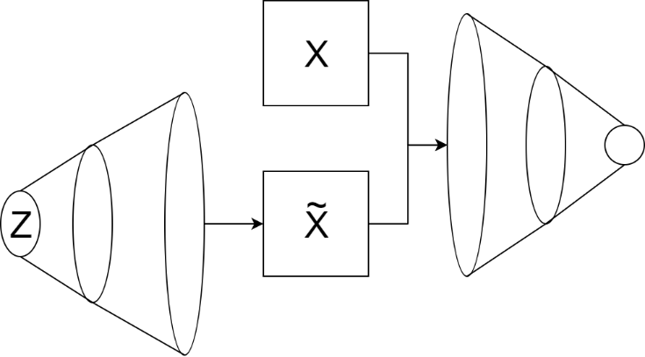
Generative Adversarial Networks
Generator learns to create images like those in dataset
Discriminator learns to recognize structure introduced by generator

Slide 31
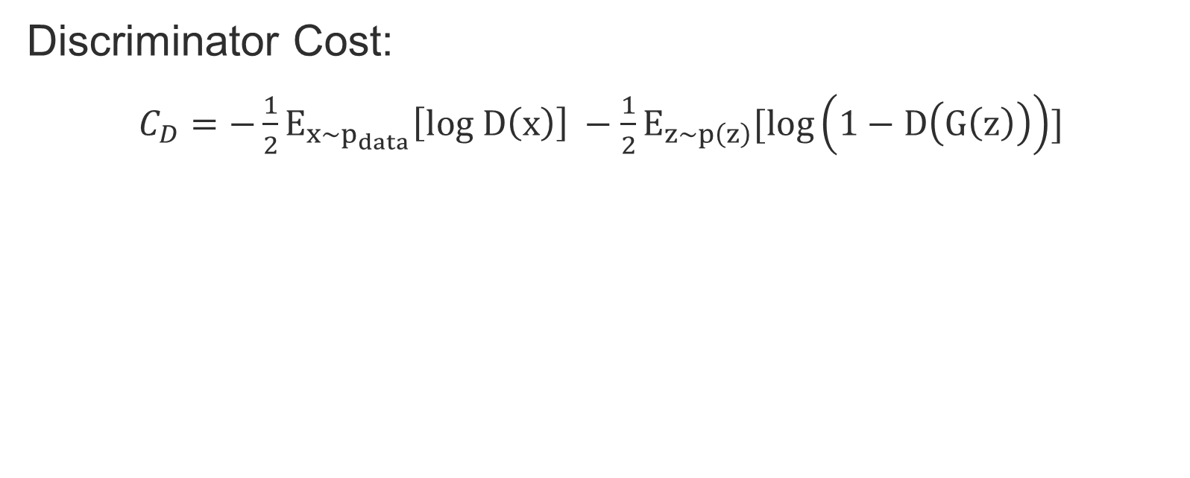
Generative Adversarial Networks
Discriminator Cost:
$C_{D}=−\frac{1}{2}E_{x\sim p_{data}}\left[log D\left(x\right)\right] −\frac{1}{2}E_{z\sim p\left(z\right)}[log\left(1−D\left(G\left(z\right)\right)\right)]$
Assign high probability to images from dataset
Assign low probability to generated images

Slide 32
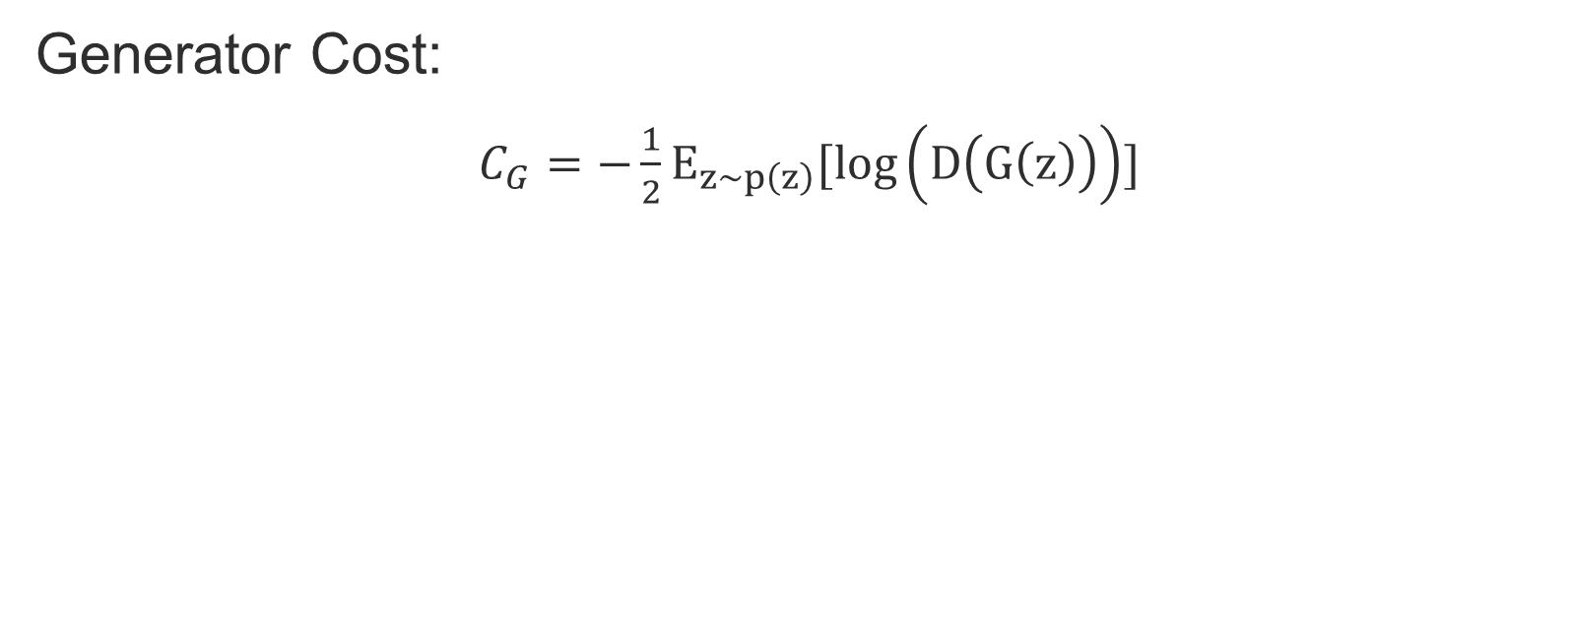
Generative Adversarial Networks
Generator Cost:
$C_{G}=−\frac{1}{2}E_{z\sim p\left(z\right)}[log\left(D\left(G\left(z\right)\right)\right)]$
Fool discriminator into assigning high probability to generated images

Slide 33
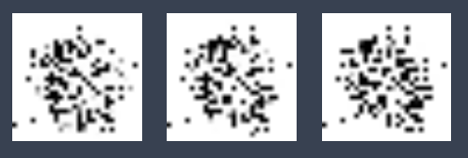
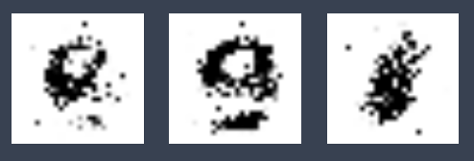





Slide 34
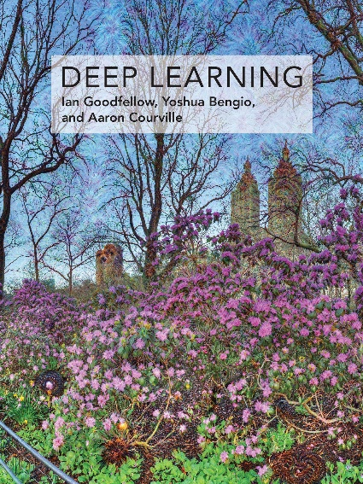
References
Deep Learning – Goodfellow, Bengio, Courville (2016).
NIPS 2016 Tutorial: Generative Adversarial Networks – Goodfellow (2017).
PixelVAE: A Latent Variable Model for Natural Images – Gulrajani et al (2016).
Tutorial on Variational Autoencoders – Doersch (2016).
Unsupervised Representation Learning with Deep Convolutional Generative Adversarial Networks – Radford, Metz, Chintala (2016).

